Slide 1

UNIT 1; With you from the start
Modern family

Slide 2
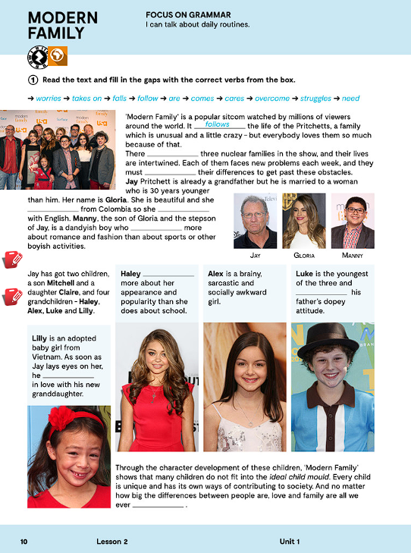
What is your family like?
Who is who in your family?
Look at the photos. Who are these people?
MODERN FAMILY is a famous American sitcom = a situation comedy

Slide 3
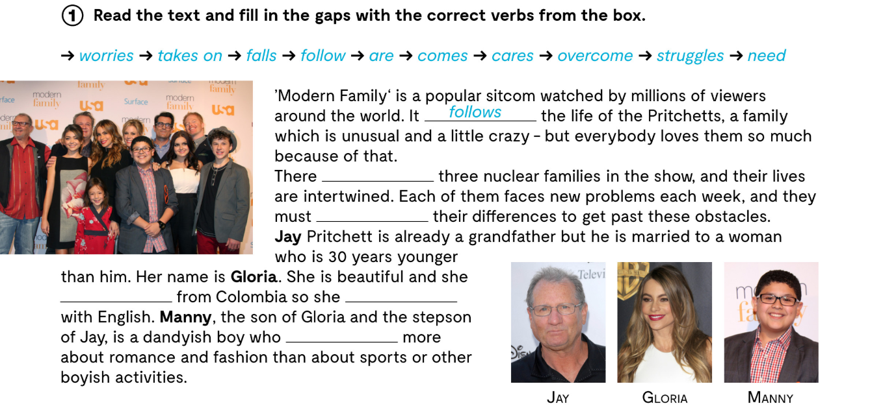

Slide 4
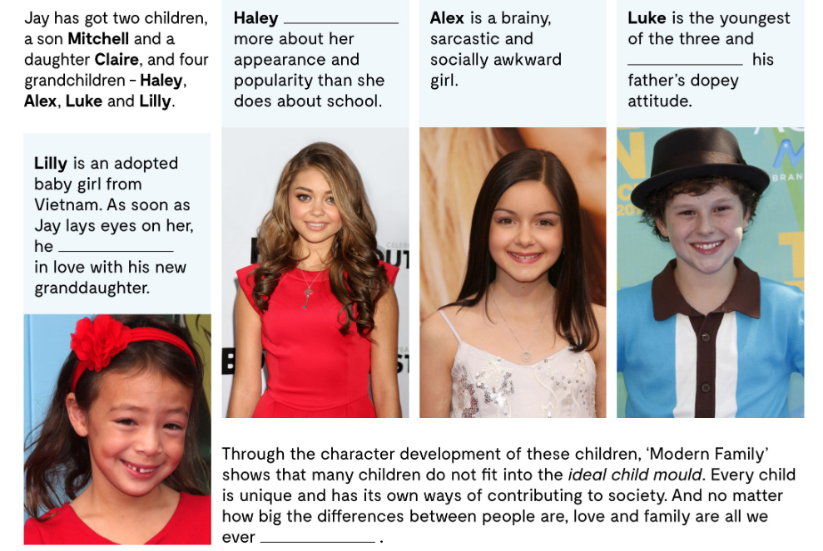
are

Slide 5
to take on
to overcome
to struggle
intertwined
to face something
obstacles
stepson
dandyish
boyish
prihvatiti
nadjačati, nadvladati
boriti se sa
isprepleteni
suočiti se sa
prepreke
posinak
poput šminkera
dječački, djetinjast
an adopted baby girl
appearance
brainy
awkward
dopey
attitude
the ideal child mould
to contribute
to mock
posvojena djevojčica
vanjski izgled
pametan
nezgodan
budalast
stav
kalup idealnog djeteta
pridonijeti
rugati se

Slide 6
.
are
overcome
comes
struggles
cares

Slide 7
worries
takes on
falls
are
need

Slide 8
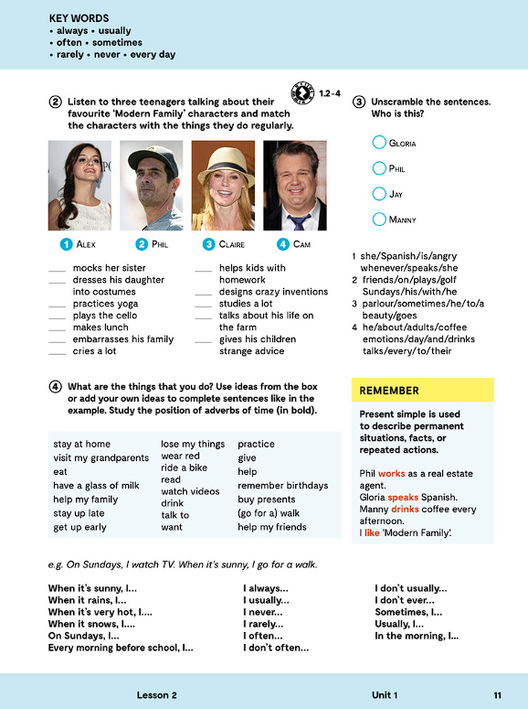
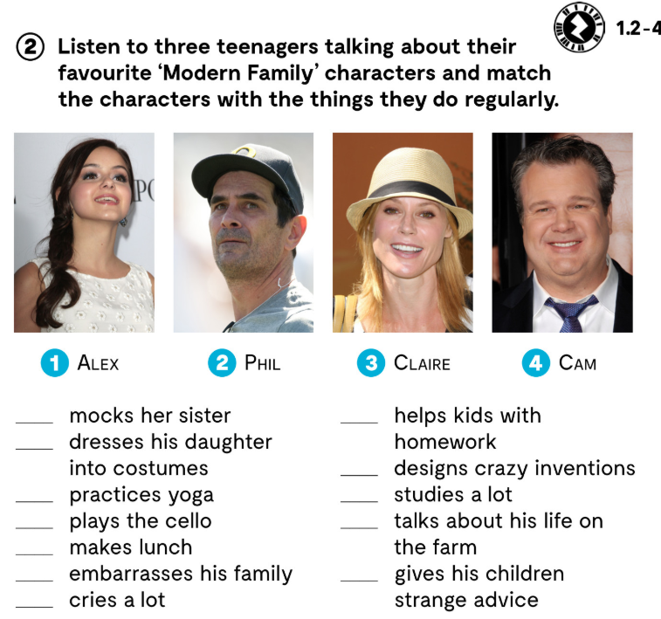

.
Audio
https://www.e-sfera.hr/dodatni-digitalni-sadrzaji/3a5fc284-4214-4c94-8078-8cfe09816a6a/assets/audio/1_2.mp3
https://www.e-sfera.hr/dodatni-digitalni-sadrzaji/3a5fc284-4214-4c94-8078-8cfe09816a6a/assets/audio/1_3.mp3
https://www.e-sfera.hr/dodatni-digitalni-sadrzaji/3a5fc284-4214-4c94-8078-8cfe09816a6a/assets/audio/1_4.mp3
Alex
Claire
Cam
Phil
Claire
Alex
Alex
Cam
Claire
Cam
Phil
Cam

Slide 9
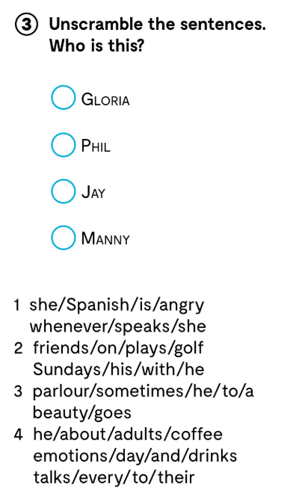
Whenever she is angry, she speaks Spanish.
GLORIA
On Sundays, he plays golf with his friends.
JAY
Sometimes, he goes to a beauty parlour.
MANNY
Every day, he drinks coffee and talks to adults about their emotions.
PHIL

Slide 10
Learn more.
Read the text and answer the questions
https://www.e-sfera.hr/dodatni-digitalni-sadrzaji/3a5fc284-4214-4c94-8078-8cfe09816a6a/

Slide 11
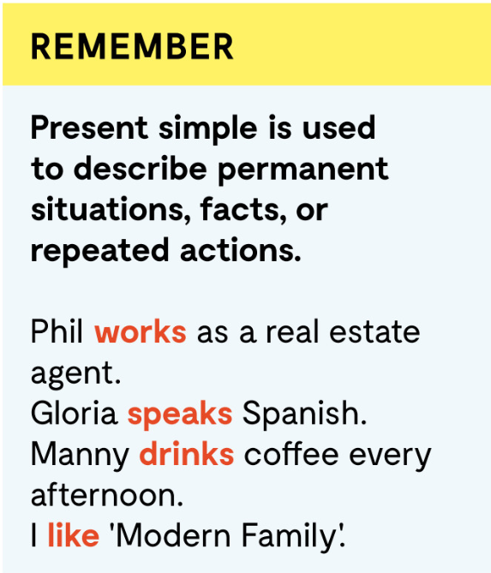


Gloria speaks Spanish.
I help my friends.
Manny drinks coffee every afternoon.
Glagolu u trećem licu jednine dodan je nastavak –s ili –es
PRESENT SIMPLE koristiš kako bi opisao trajne situacije, činjenice ili radnje koje se ponavljaju (uz priloge učestalosti: always, sometimes, usually, often, never, every day).

Slide 12
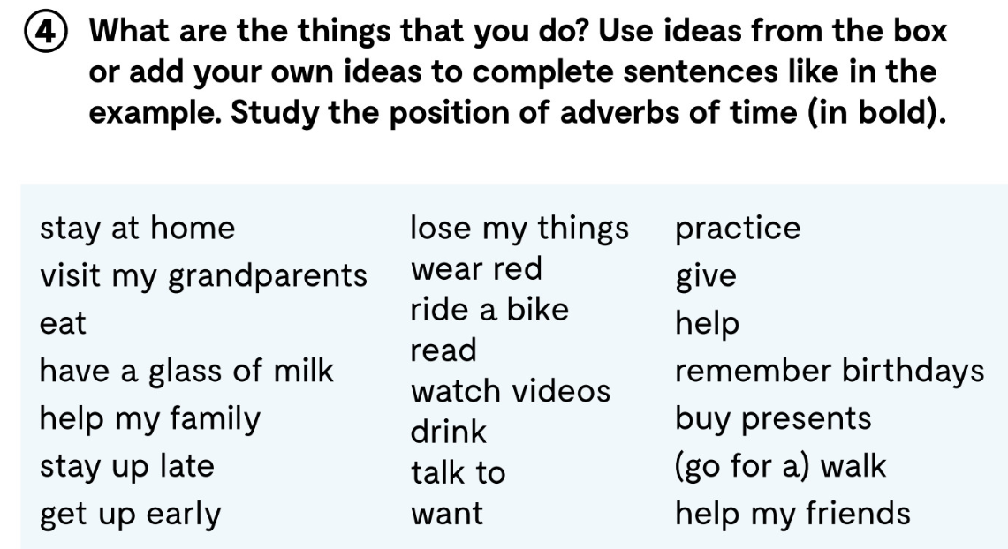
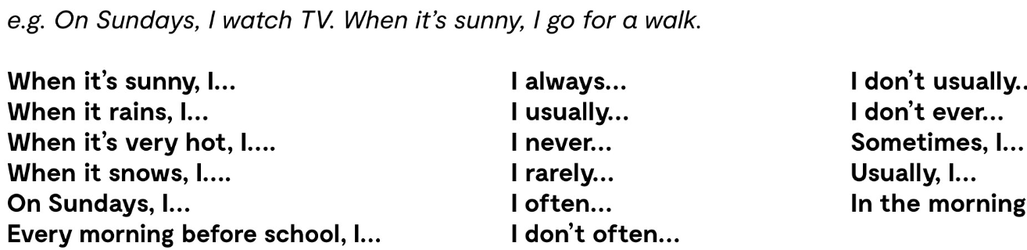

Slide 13
Present Simple practise
https://learningapps.org/watch?v=pd4q37nuk20
https://learningapps.org/watch?v=pmqifmvqa20

Slide 14
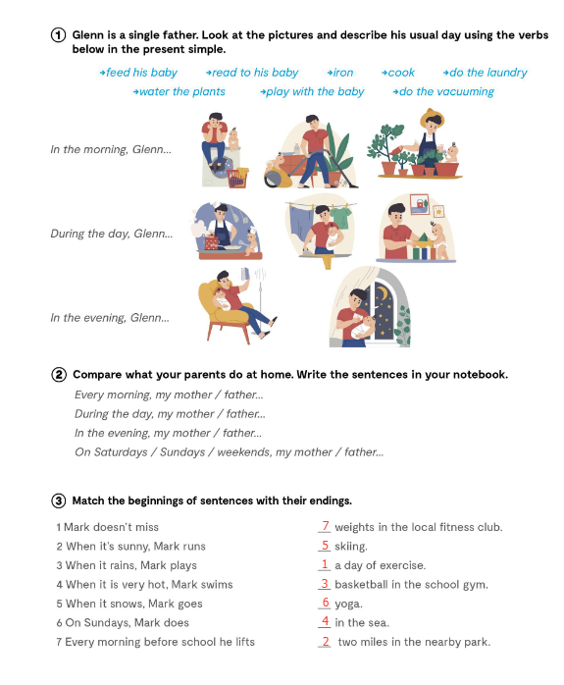

Slide 15
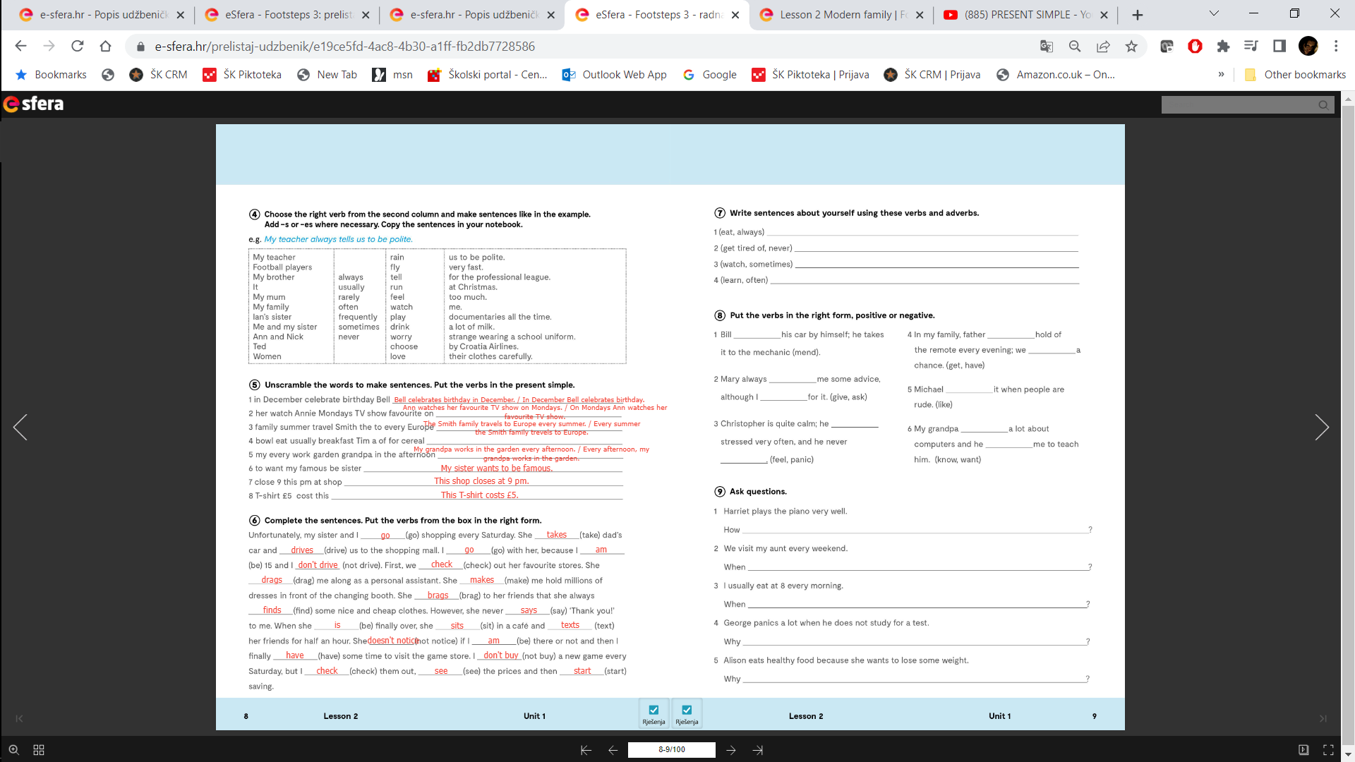

Slide 17
